Slide 1


Your Health in a Breath
International Conference on Health, Healthcare and Eco-civilisation
Thomas Lundeberg
托马斯•兰德伯格
A novel technique for the assessment of volatile organic compounds in the environment and in human breath
评价环境和人类呼吸中挥发性有机化合物的一项新技术

Slide 2
Trends in healthcare
This is already happening
Growing world population
Aging world population
Demand for increased health care
Increase of diseases like cancer, diabetes, obesity and COPD
Need for faster, better, cost-effective diagnostic methods
…beyond conventional laboratory medicine…

Slide 3
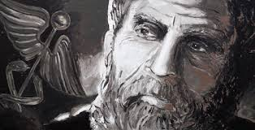
Breath analysis
The Wall Street Journal October 9th , 2012
The concept goes back to Hippocrates, who wrote a treatise on breath aroma and disease around 400 B.C.
It's the ultimate noninvasive medical test: A growing number of health problems can be diagnosed by analyzing a patient's breath alone.
"Anything you can have a blood test for, there is potentially a breath test for, as long as there is a volatile - capable of readily changing from a solid or liquid form to a vapor – component.
VOC: Volatile Organic Compound

Slide 4
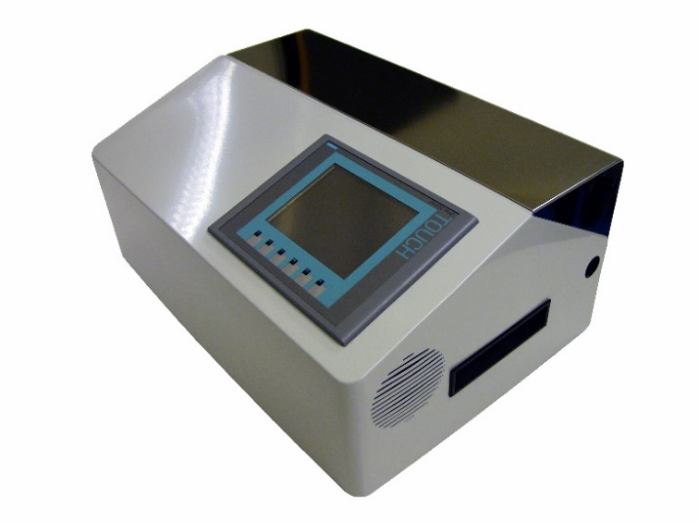
DUVA
Deep Ultra Violet Analyzer
Spectrum in the deep ultra violet range [125-330] nm
Sequential analysis of different VOCs
”Non destructive” analysis of VOCs – compared to MS
Measurable quantity of original substance – down to pico gram
Proprietary technology

Slide 5
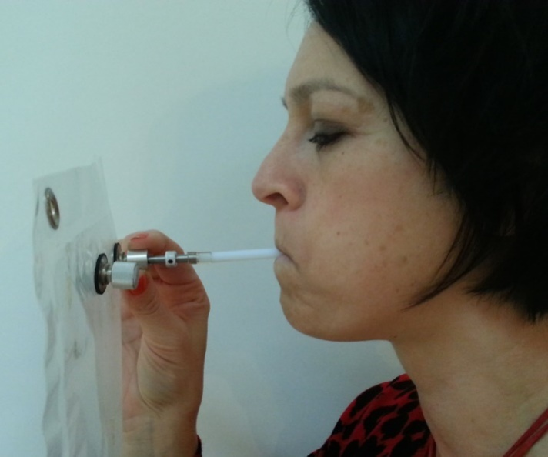
Pre analytic phase
Sample collection
As little as half a liter of exhaled air sampled in a “plastic” bag is enough to detect chemical substances that originates from tissues.
This kind of sample collection is already used today for a number of standard laboratory tests, in example for detection of Helicobacter pylori (ulcer)

Slide 6
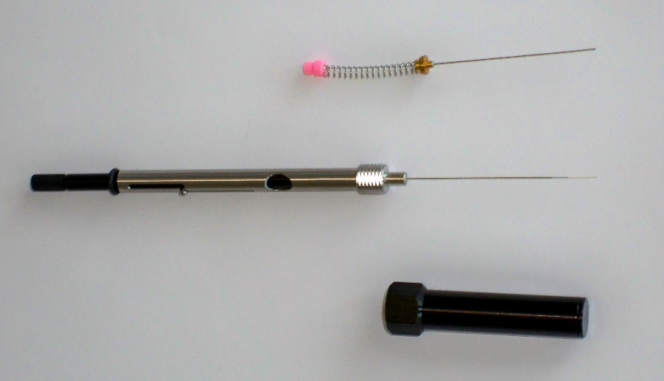
Pre analytic phase
Sample extraction
SPME: Solid-phase microextraction
The needle is inserted into the plastic bag and VOCs are captured in the fiber.
Fast and simple procedure

Slide 7
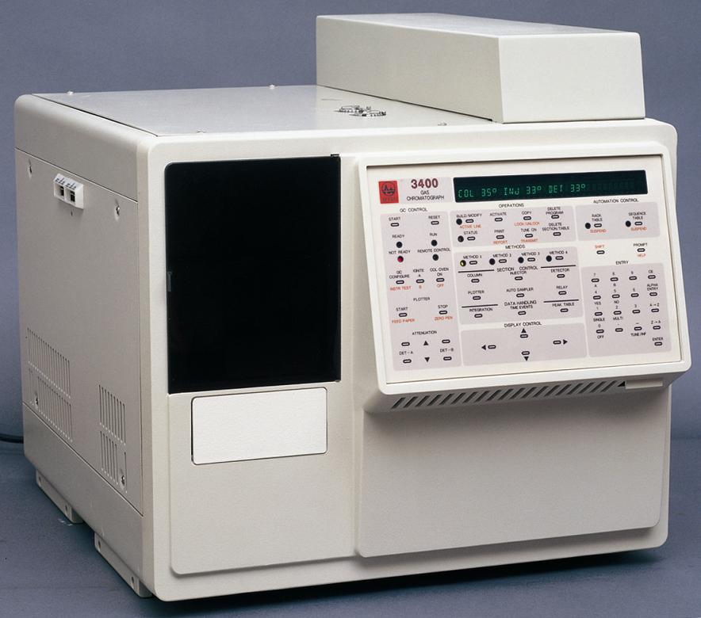
Pre analytic phase
Pre-processing
Gas chromatography: all substances are sequentially separated in gas phase in order of boiling point/vaporized pressure.
Helium or Nitrogen are used as gas carriers
The SPME is inserted in the chromatograph and gas is injected in the system

Slide 8
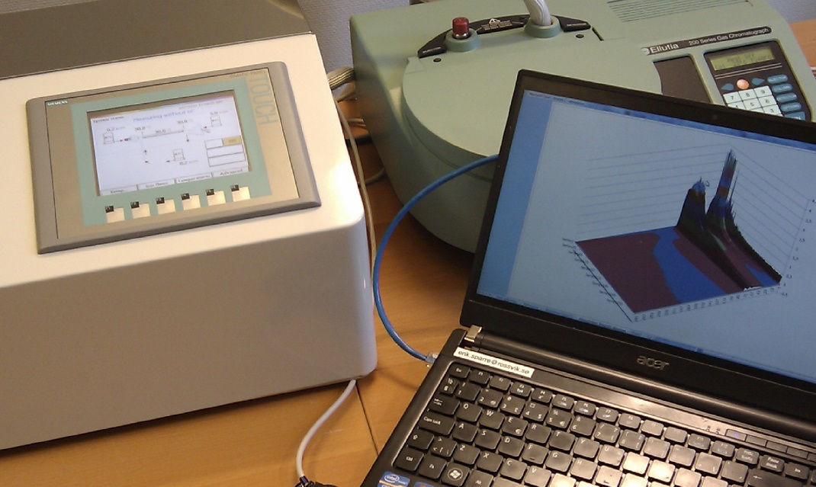
Analysis
Absorbance spectrum
The absorbance spectrum is measured and
recorded in the DUVA control center
The data is post-processed and matched with
a database of VOCs
A database with the spectrum of over 1300 VOCs

Slide 9
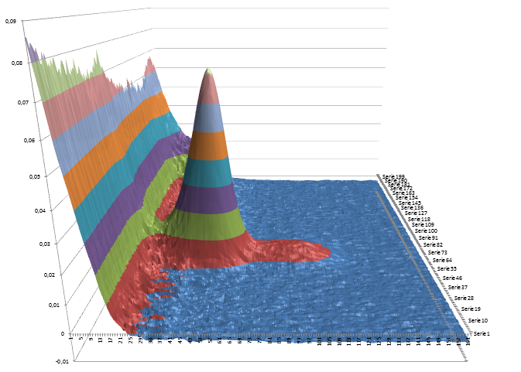
Detection
British Journal of Surgery, January 2013
“Exhaled volatile organic compounds identify patients with colorectal cancer”
Gas-chromatography mass-spectroscopy
15 compounds identified
37 patients
Overall accuracy of 76%

Slide 10
Detection
Cancer Medicine, February 2014
“Exhaled volatile organic compounds identify patients with lung cancer”
Early detection is a key factor for increasing survival
4 compounds identified in 97 patients
late stages (II-IV) had higher levels
Overall accuracy of 83%

Slide 11
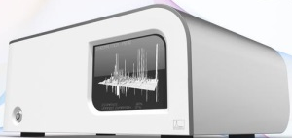

Conceptual
One instrument type and One system for multiple health checks for future medical care
Distributed test instruments
Data Communication
Central data base
Data compilation
Central control

Slide 12
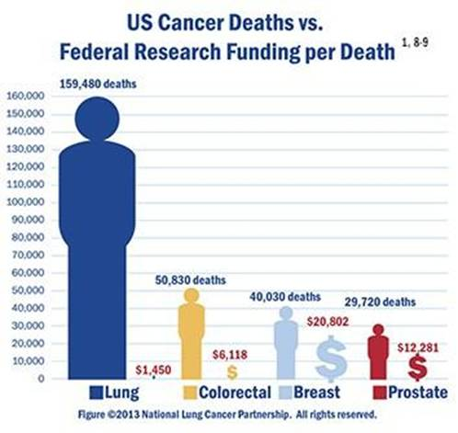
Primary aim
Early detection
Early detection of lung cancer
Early detection of colorectal cancer
Treatment assessment
Follow-ups

Slide 13
